Slide 1
CCS Update Dec. 2022
Michael Pyrcz and Murray Christie
The University of Texas at Austin and S&P Global

Slide 2
IMAGE Tradeshow
Michael J. Pyrcz, Associate Professor
Cockrell School of Engineering and Jackson School of Geosciences, The University of Texas at Austin
Murray Christie, Executive Director
Geoscience & Engineering Commercialization, Energy

Slide 3
Agenda
Robust Data Analytics and Machine Learning Workflow for Basin-Scale Carbon Storage Potential
Challenges:
Combining multiple data sources?
Big data analytics, visualization and domain expertise driven-insights
What matters? Advanced feature selection.
Consistent mapping of CS potential?
Improved data analytics for new insights and optimum development.

Slide 4
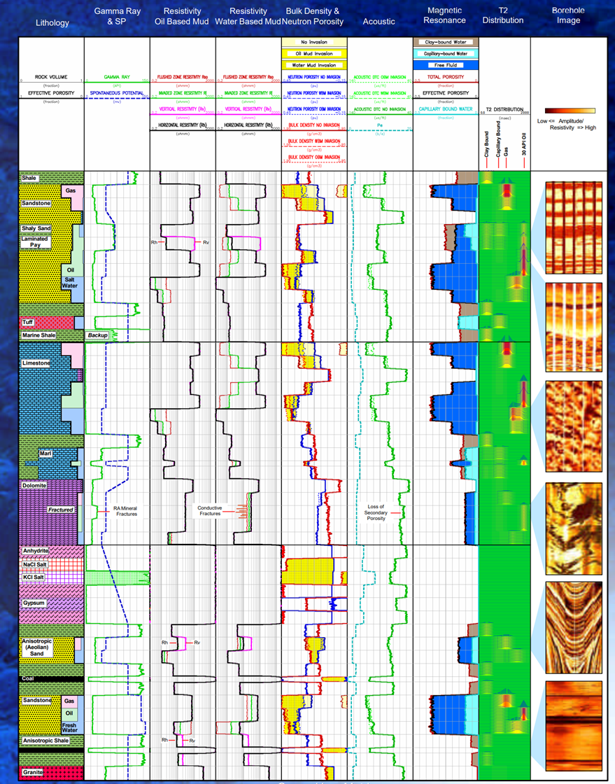
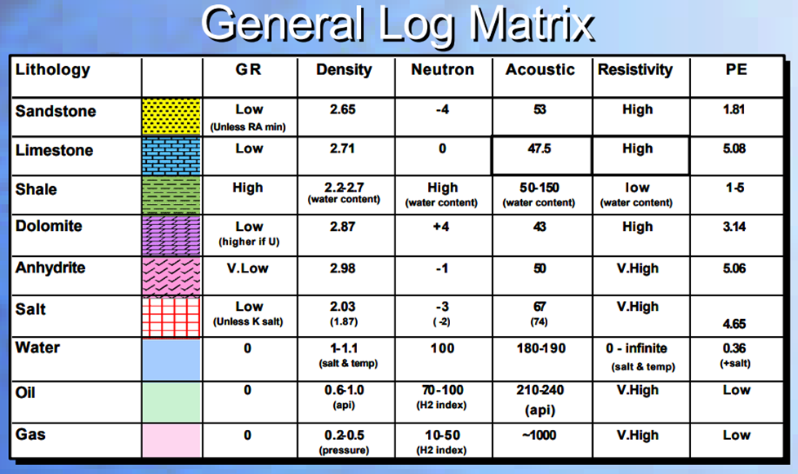
Agenda

Slide 5
Opportunities
operational decisions required for CCUS potential assessment are improved with robust use of data analytics to address the challenges of multiscale, incomplete, biased, or uncertain data
integration of robust spatial data analytics, geostatistics and machine learning to support carbon storage potential in the Gulf of Mexico
Basin Scale CCUS Spatial Data Analytics and Modeling
Basin Scale CCUS Feature Selection
Basin Scale CCUS Potential Maps

Slide 6
Data Analytics and Data Visualization Methods
Flexibility to filter well data by:
Constants
Conditional to depth outliers
Data Visualization:
Feature by depth with conditional intervals
Data points and data density (2D histograms)
Proportion of data retained and filtered (2D histograms)
Conditional expectation for trend models
Basin Scale CCUS Spatial Data Analytics and Modeling
Basin Scale CCUS Feature Selection
Basin Scale CCUS Potential Maps

Slide 7
Data Analytics and Data Visualization Methods
Data Filters
Basin Scale CCUS Spatial Data Analytics and Modeling
Basin Scale CCUS Feature Selection
Basin Scale CCUS Potential Maps

Slide 8
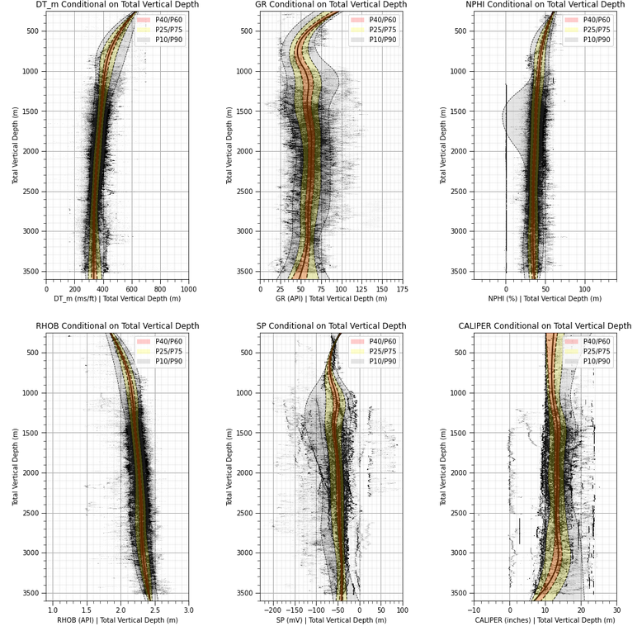
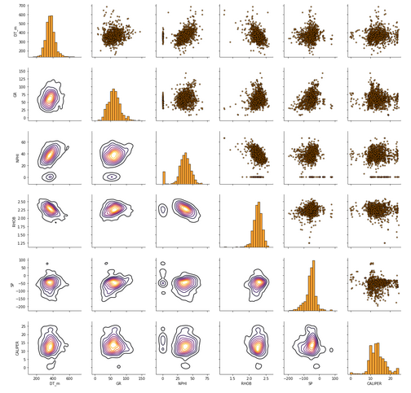
Well Data Filtering
issues with multiple populations, data noise, etc.
All data matrix scatter plot.
Various structures in the data to explore.
All well data depth conditional distributions.

Slide 9
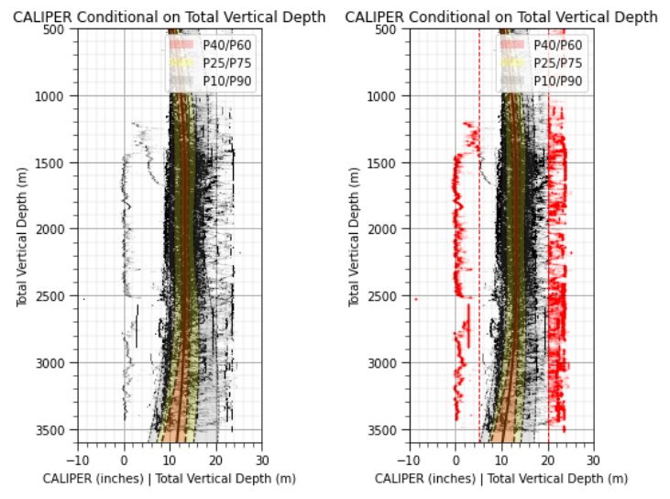
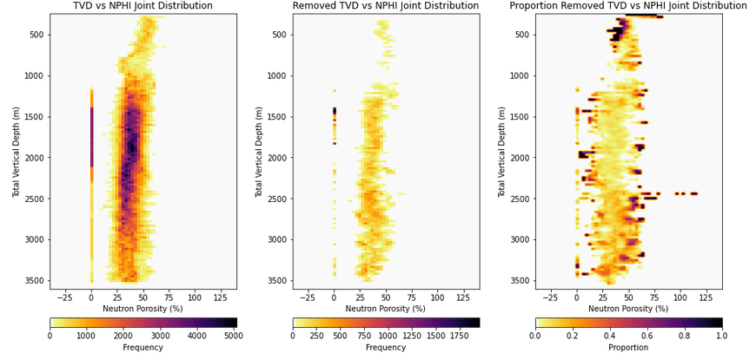
Well Data Filtering – Caliper
Filter #1, erroneous caliper log
Assign minimum and maximum caliper values
Caliper filter removes extreme NPHI values by depth.
Filter #1 retained (left), removed (center), and proportion removed (right).
Filter #1 all data (left) and filtered data (right).

Slide 10
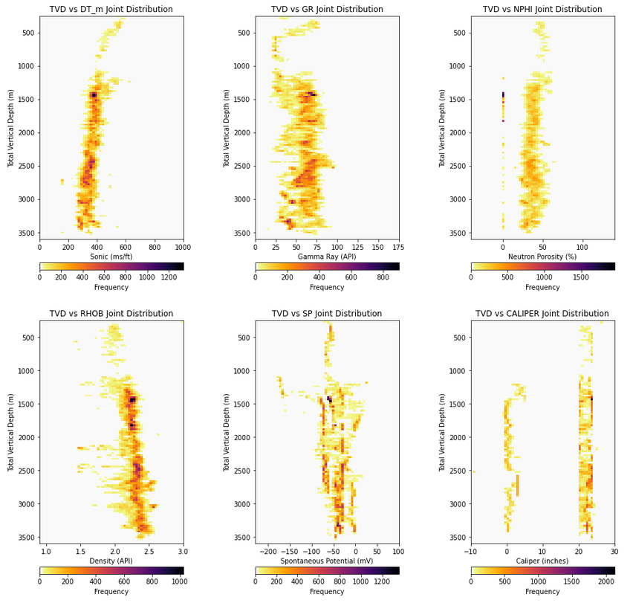
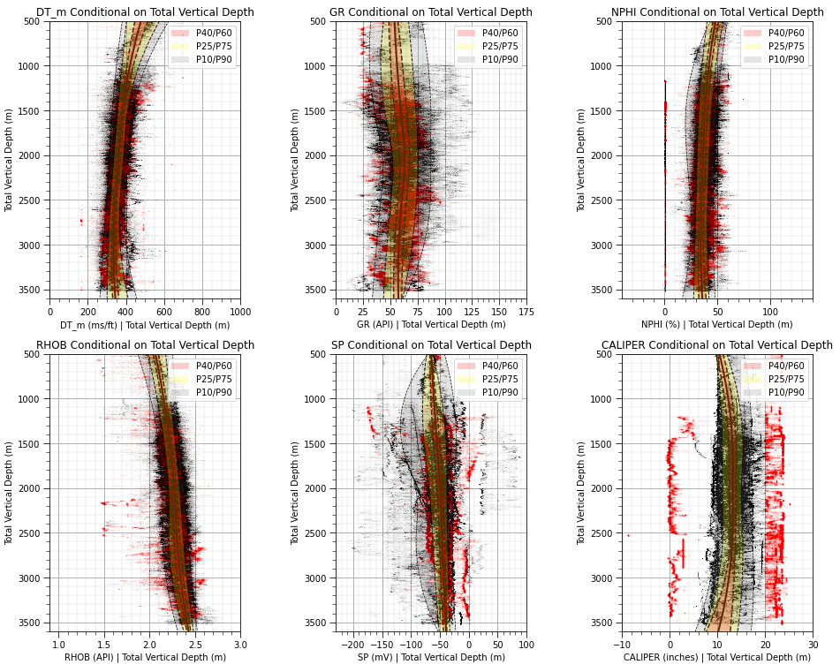
Well Data Filtering - Caliper
Filtered well data depth 2D histograms.
Filtered well data depth conditional distributions.

Slide 11
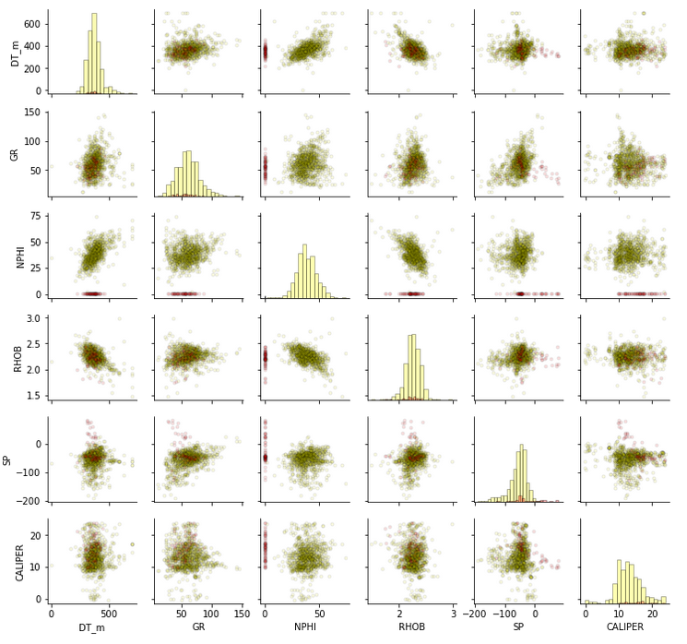
Well Data Filtering - Porosity
Matrix scatter plot, retained (yellow), removed (red).

Slide 12
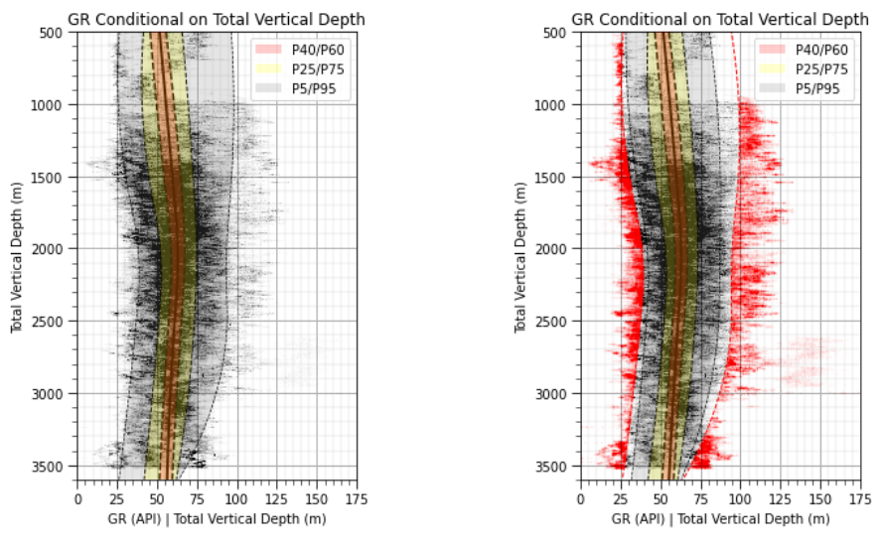
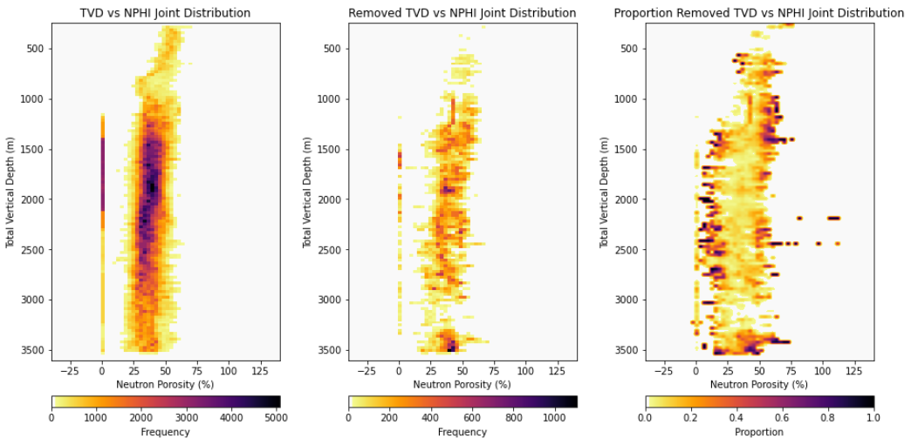
Well Data Filtering – Depth Outliers
Filter #3, conditional outliers in depth
Demonstrated with gamma ray, could be applied to any well log for any outlier alpha value assignment.
Demonstration, we could filter conditional depth outliers for any well log.
Filter #3 retained (left), removed (center), and proportion removed (right).
Filter #3 all data (left) and filtered data (right).

Slide 13
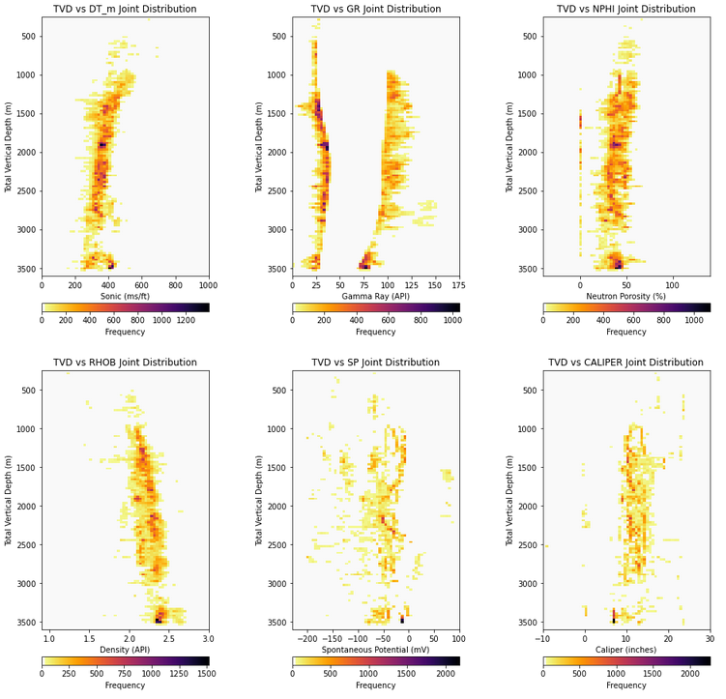
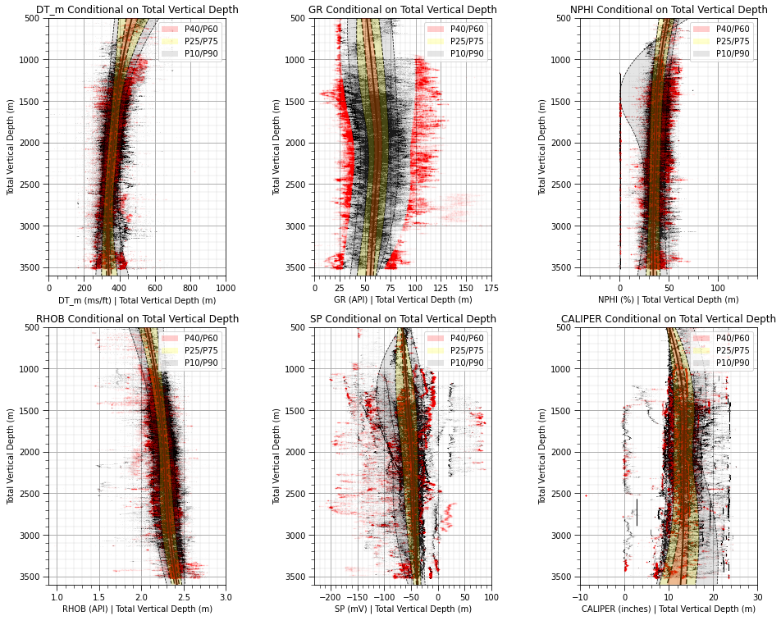
Well Data Filtering – Depth Outliers
Filtered well data depth 2D histograms.
Filtered well data depth conditional distributions.

Slide 14
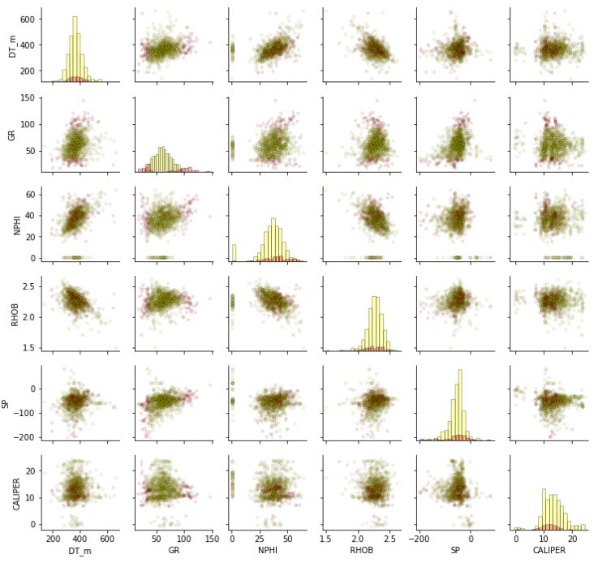
Well Data Filtering – Depth Outliers
Matrix scatter plot, retained (yellow), removed (red).

Slide 15
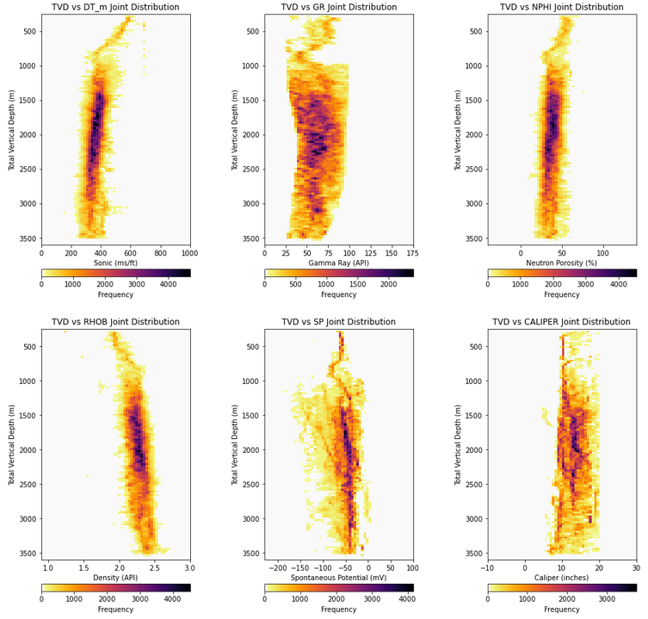
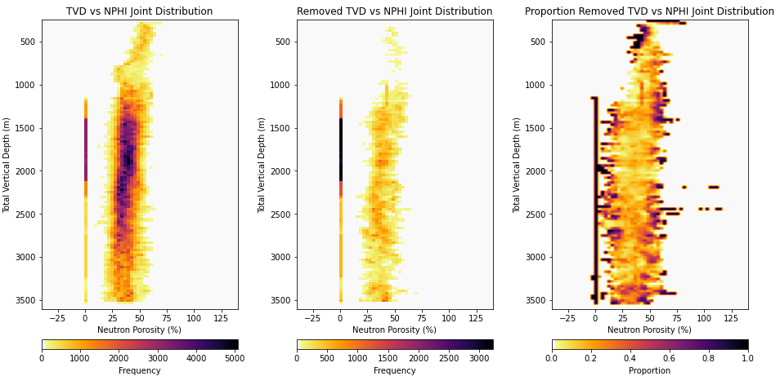
Well Data Filtering – Combined
Filters #1, #2 and #3 combined
Using OR operator, remove any well data identified by any filter
Filter #3 retained (left), removed (center), and proportion removed (right).
Retained data 2D histogram for all filters combined.

Slide 16
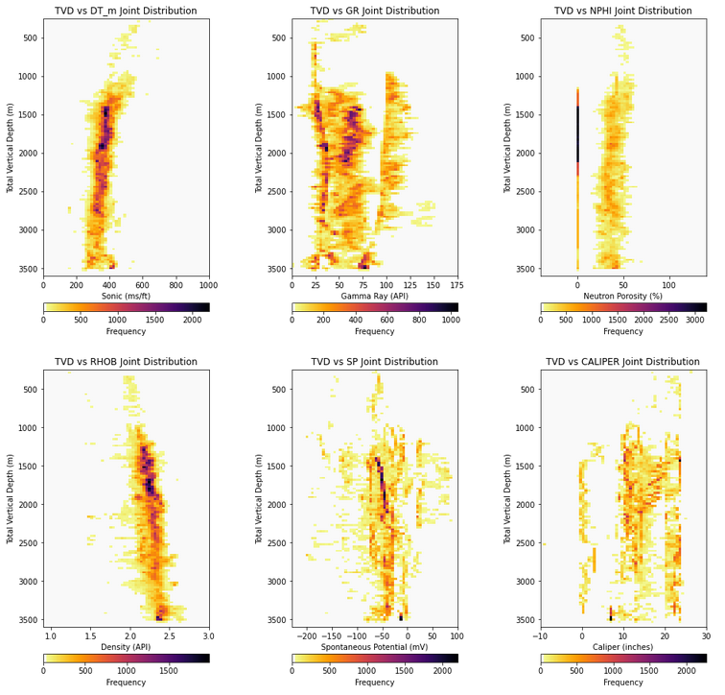
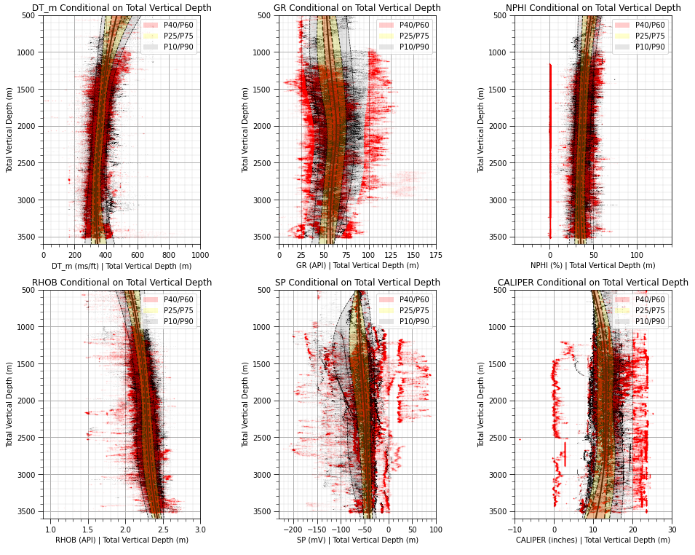
Well Data Filtering – Combined
Filtered well data depth 2D histograms.
Filtered well data depth conditional distributions.

Slide 17
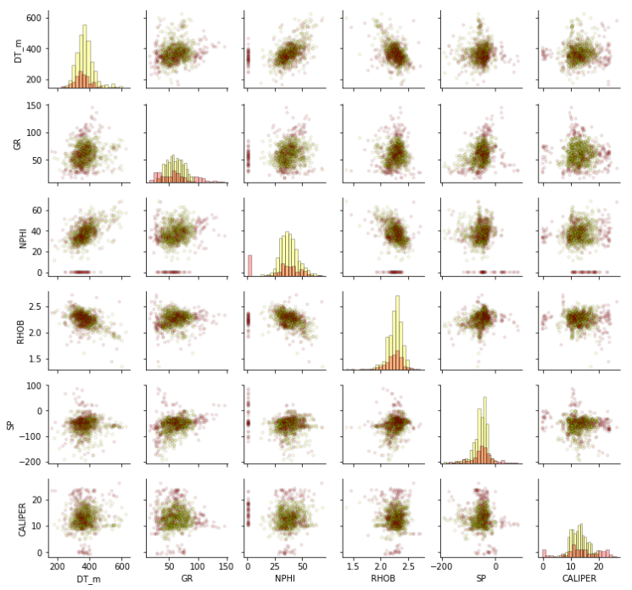
Well Data Filtering – Combined
Matrix scatter plot, retained (yellow), removed (red).

Slide 18
Data Analytics and Data Visualization Methods
Machine learning-based gamma ray prediction, fast attempt
Basin Scale CCUS Spatial Data Analytics and Modeling
Basin Scale CCUS Feature Selection
Basin Scale CCUS Potential Maps

Slide 19
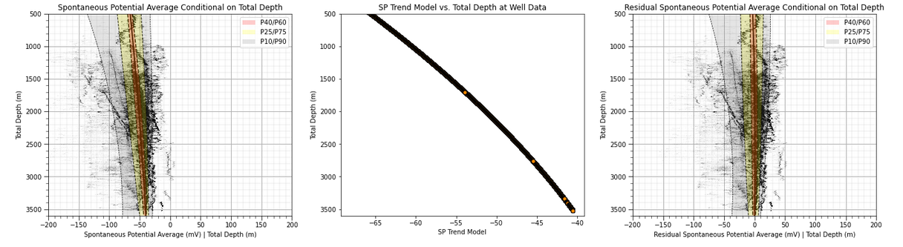
Gamma Ray Imputation – Fast Attempt
spontaneous potential (SP) well log depth trend model and calculation of a stationary residual to inform gamma ray (GR)
Take the combined filtered data and ‘fast attempt’ gamma ray prediction
SP depth detrended
SP depth trend
Conditional distributions for spontaneous potential vs. depth (left), model of expected SP as a function of depth (center), residual spontaneous potential (right).

Slide 20
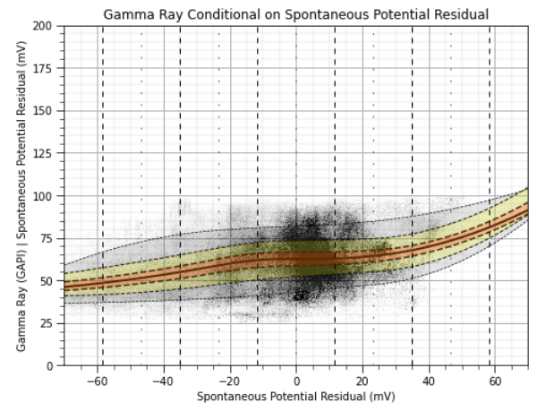
Gamma Ray Imputation – Fast Attempt
spontaneous potential (SP) residual does not have a significant relationship with gamma ray, not currently suitable for imputation.
Conditional distributions for gamma ray vs. spontaneous potential residual.

Slide 21
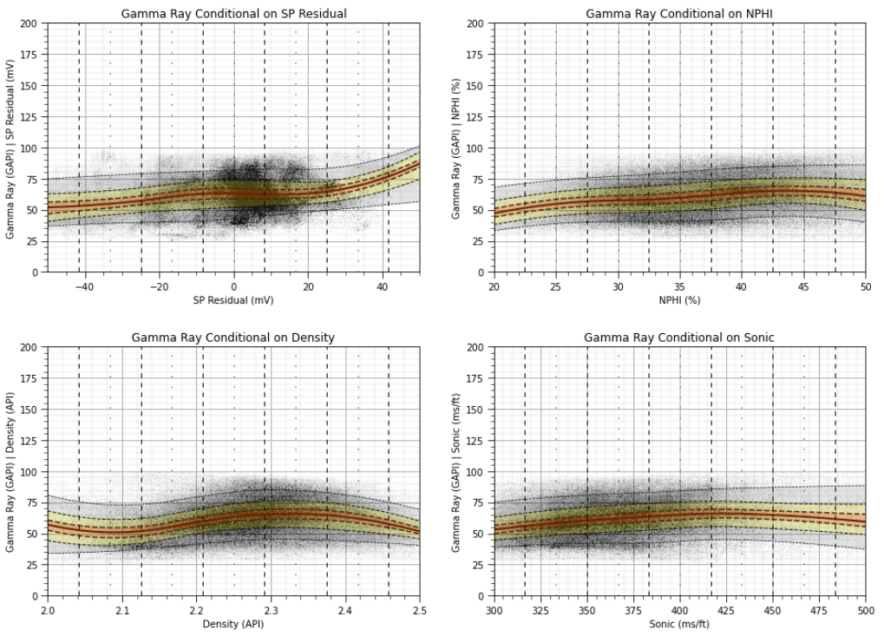
Gamma Ray Modeling – Fast Attempt
First pass to check for pairwise relationships between potential predictor features and gamma ray.
Conditional distributions, one-at-a-time for gamma ray given each potential predictor feature.

Slide 22
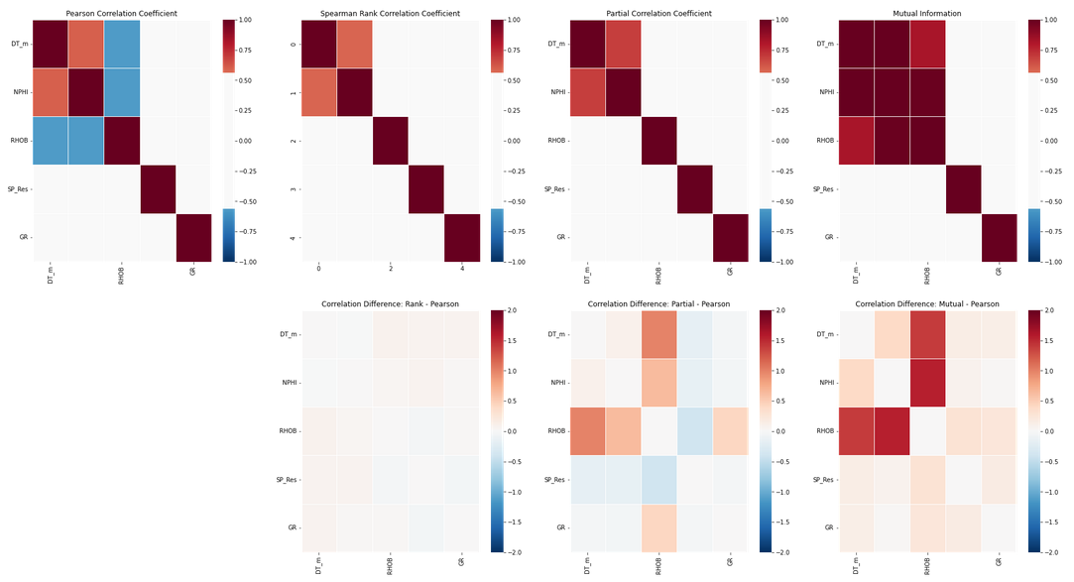
Gamma Ray Modeling – Fast Attempt
Check pairwise correlations and mutual information between all features.
Correlation and delta correlation matrices.
Confounding features are disrupting RHOB-DT_m and RHOB-NPHI correlation.
Nonlinearity are disrupting RHOB-DT_m and RHOB-NPHI correlation.

Slide 23
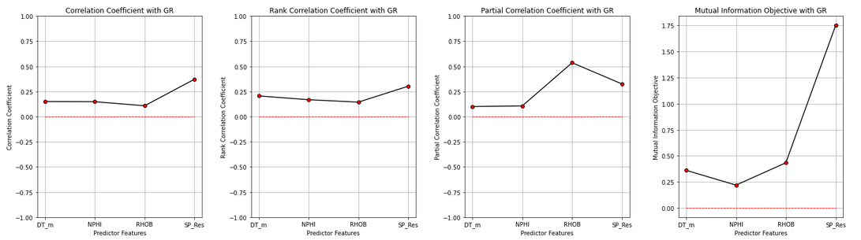
Gamma Ray Modeling – Fast Attempt
Check pairwise correlations and mutual information between all features.
Feature importance by correlation and mutual information.

Slide 24
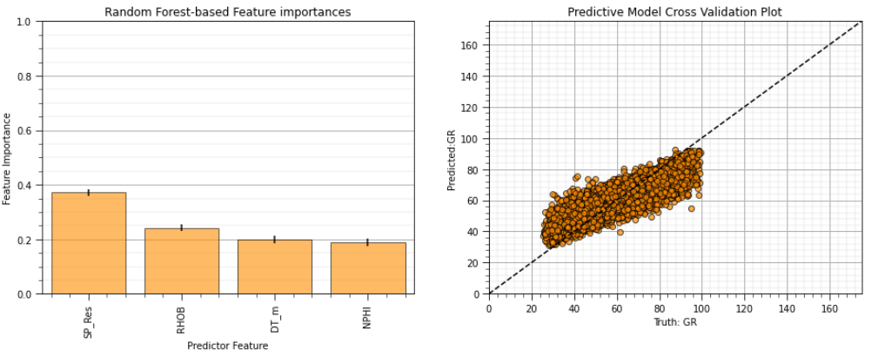
Gamma Ray Modeling – Fast Attempt
Random forest model to predict gamma ray from spontaneous potential, sonic, density, neutron porosity.
SP residual is top feature, then RHOB, DT_m and NPHI.
This agrees with mutual information!
Feature importance (left) and model cross validation (right).

Slide 25
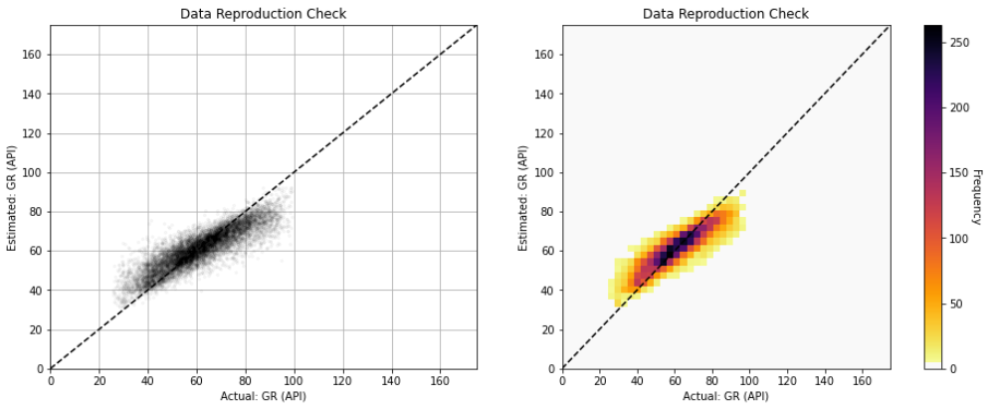
Gamma Ray Modeling – Fast Attempt
Random forest model to predict gamma ray from spontaneous potential, sonic, density, neutron porosity.
Enhanced modeling checking to identify global and conditional bias.
Conditional bias, suggesting slight underfit.
Model cross validation scatter plot (left) and model cross validation 2D histogram (right).

Slide 26
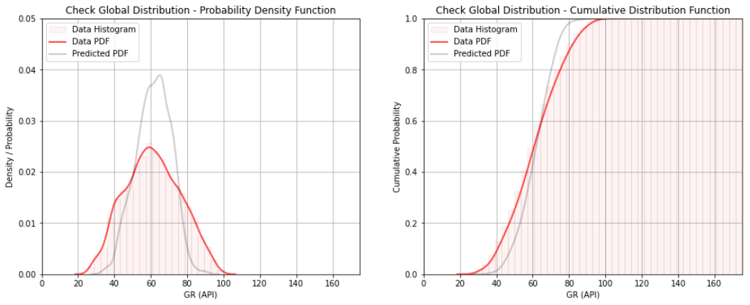
Gamma Ray Modeling – Fast Attempt
Random forest model to predict gamma ray from spontaneous potential, sonic, density, neutron porosity.
Enhanced modeling checking to identify global and conditional bias.
Regression to mean, reduction in prediction variance.
Model cross validation scatter plot (left) and model cross validation 2D histogram (right).

Slide 27
Data Analytics and Data Visualization Methods
Conditional spontaneous potential-based sand and shale model
Basin Scale CCUS Spatial Data Analytics and Modeling
Basin Scale CCUS Feature Selection
Basin Scale CCUS Potential Maps

Slide 28
Gamma Ray Modeling – Sand and Shale Model
Back up to caliper only filter and attempt a sand and shale split on spontaneous potential residual
Filter outlier caliper values from wells
Trend model SP by depth and detrend to calculate SP_Res
Classify Facies:
P0 - P10 conditional to depth: Sand
P90 - P100 conditional to depth: Shale
P10 - P90 conditional to depth: Mixed
Given this model applies conditional probabilities by depth the model is depth-wise heteroscedastic as it accounts for observed changes in variance of SP residual over depth.

Slide 29
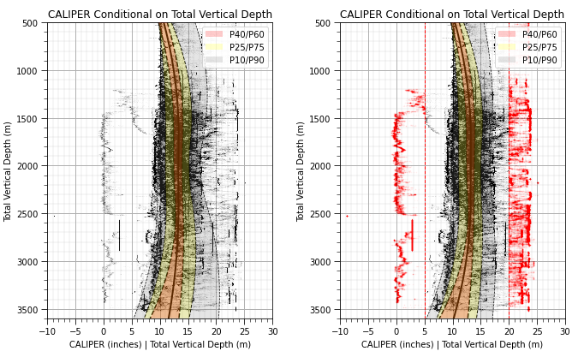
Gamma Ray Modeling – Sand and Shale Model
Back up to caliper only filter and attempt a sand and shale split on spontaneous potential residual
Filter outlier caliper values from wells
Alpha level of 20%, P10/P90 selected for caliper outliers
Filter all well data (left) to remove outlier caliper measures (right).

Slide 30
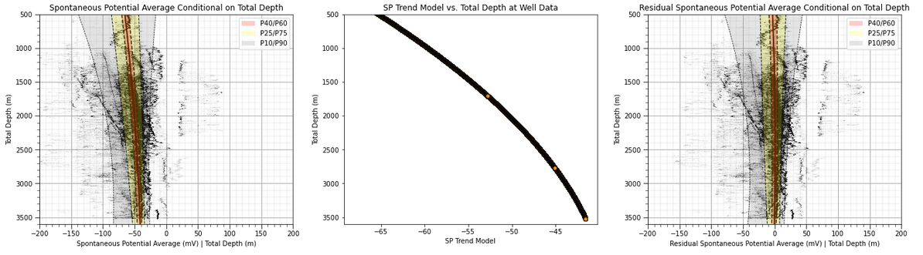
Gamma Ray Modeling – Sand and Shale Model
Back up to caliper only filter and attempt a sand and shale split on spontaneous potential residual
Trend model SP by depth and detrend to calculate SP_Res
Conditional distributions for spontaneous potential vs. depth (left), model of expected SP as a function of depth (center), residual spontaneous potential (right).

Slide 31
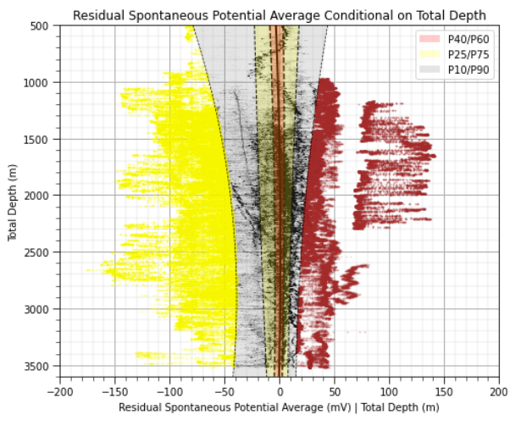
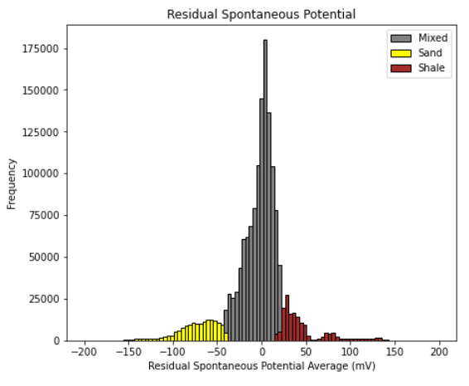
Gamma Ray Modeling – Sand and Shale Model
Back up to caliper only filter and attempt a sand and shale split on spontaneous potential residual
Classify Facies:
P0 - P10 conditional to depth: Sand
P90 - P100 conditional to depth: Shale
P10 - P90 conditional to depth: Mixed
Filter on very low NPHI removes this data.
Overlap due to conditional to depth facies thresholds
Caliper filtered wells residual spontaneous potential vs. depth with conditional probabilities and sand (yellow) and shale (brown) facies assignments.
Residual spontaneous potential with sand (yellow) and shale (brown) facies assignments.

Slide 32
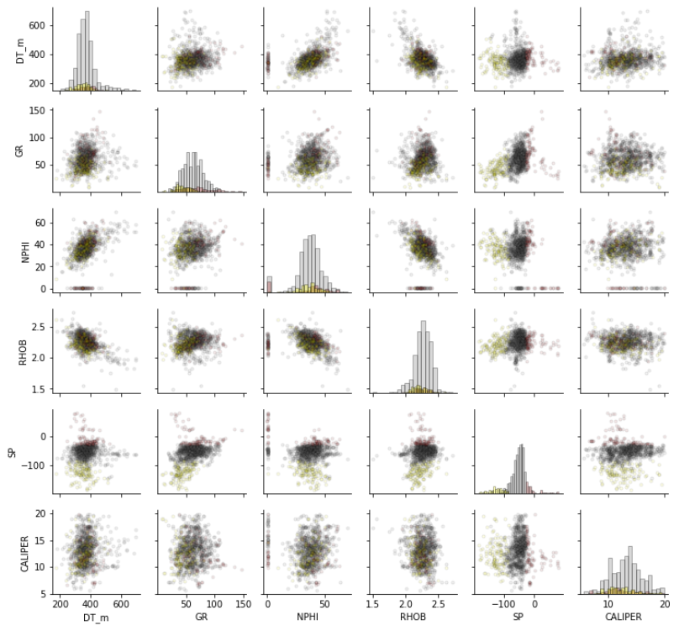
Gamma Ray Modeling – Sand and Shale Model
Back up to caliper only filter and attempt a sand and shale split on spontaneous potential residual
Matrix scatter plot of caliper filtered data with facies assignment, sand (yellow), shale (brown) and mixed (grey).

Slide 33
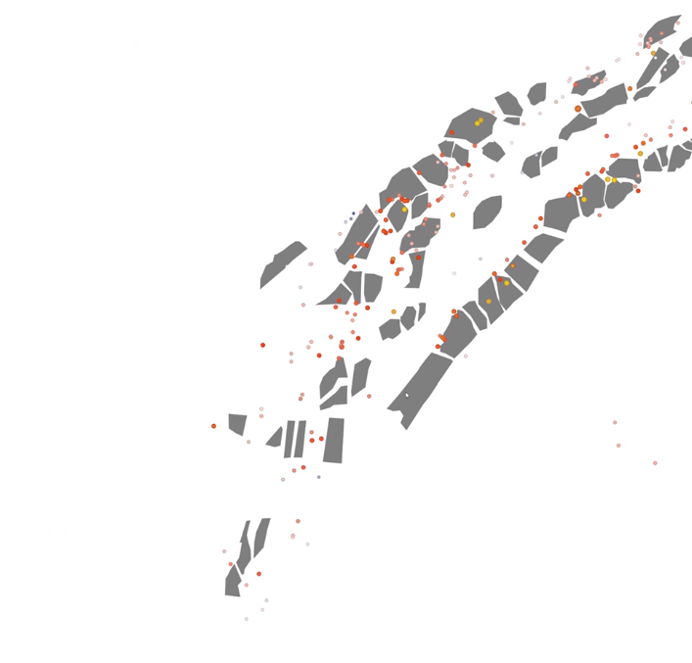
Next Steps
Review of results
Machine learning model to predict sand and shale facies for automated classification of facies from well data
Modeling of SP/GR trends by-facies
Assess opportunities for dimensionality reduction, inferential machine learning
GR Normalization issue with every well, by logging run. Use wells nearby to detect, raster assist? Goal is to find best sand.
Identify baseline trends and baseline shifts,
Autoencoder, RNN detect artifacts (GR shifts) using multiple logs.
Discrepancy modeling, use physics + ML to impute and detect anomaly in well logs.
Spotfire to Python and R. Still use workbooks.
Step 1 – detect shifts, using spatial, then try mutlivariate (density, resistivity is best is best for shifts)
Step 2 – simple offset, or just detect the big sand, confident it is not a baseline shift! Image, CCS SPE conference.

Slide 34
Thank you! Any Questions?

